Slide 1
Gender
1. Sex and gender
Sex and temperament (M. Mead)
Temperament and culture
Recurrent gender patterns
Peruvian market women

Slide 2
1. Sex and gender
Sex: biological difference (sexual dymorphism).
Gender: a cultural construction, the meaning ascribed to biological difference (what does it mean to be M,F or other)
Nature/biology (A) vs. nurture/culture (B) debates: Are we, as gendered beings, the product of biology or of culture?
For (A) to be correct we would expect: universality of gender roles, no historical change, limited range of gender behavior.
For (B) to be correct we would expect: culturally contingent gender roles, change over time, ample range of gender behavior.

Slide 3
2. Sex and temperament (M. Mead, 1935)
Central objective: To examine if and how the “temperament” of people from different societies was sex-linked.
Assumption: If temperament is sex-linked, it should be consistently the same from society to society.
Studied 3 neighboring populations in Papua New Guinea.
Found variation in gender behavior and temperament among the three groups and concluded that personality traits assumed to be “masculine” or “feminine” were the product of socialization in diverse cultural settings.

Slide 4
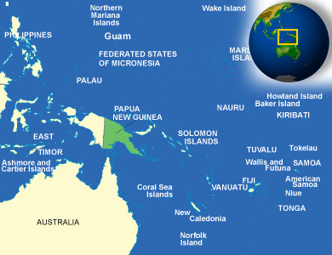
Mead´s research setting
Arapesh
Mundugamor
Tchambuli

Slide 5
3. Temperament and culture
If it is true that it is culture and not nature that shapes temperament, what are the origins of the patterns observed in human societies? (e.g. why do both males and females among the Mundugamur tend to have a docile and nurturing temperament?)
Mead argued that societies selected from a broad range of temperaments and favor particular ones as models for gendered behaviors.
Biological propensities towards certain temperament do exist. These are encouraged or overridden through the process of socialization, creating patterned cultural behavior.

Slide 6
4. Recurrent gender patterns
Kottak’s cross-cultural and historical examination of gender patterns suggests that at at different historical and economic junctures, certain gender patterns become more common:
Patrilineal-patrifocal-patriarchal systems, associated with a sharp public (M)-domestic (F) dichotomies, are very common today (even deemed “natural”).
Yet, this pattern was likely uncommon throughout much of human history (hunter-gatherer societies tend to be notoriously egalitarian {equality} in gender matters).
The existence of other social systems (e.g. matrilineal-matrifocal-matriarchal) is also evidence that no single pattern is inherent to the human species.
In all social settings, though, gender role expectations are supremely important to social dynamics.
Notes:
Patriarchal is male based, father lineage
p.174 – bottom of the page, Kottak and gender in historical context
Gender stereotypes
Learning cultural patterns when models no or different models regarding gender
Cultural genders beyond binary were all over the world yet has been subjected to the binary norms
But in societies that support beyond the binary have been supported and have had status
Changes to economic systems also change gender roles as well, what are the factors contribute to one gender role
Gender <<>> Culture

Slide 7
5. Peruvian market women
Seligman combines analysis of class and gender to contextualize perceptions of Peruvian market women in Cuzco and to understand the effect of their family dynamics on their economic standing:
Perceived as a social/gender anomaly.
Trapped in dysfunctional family dynamics (absent husbands, abuse, etc.).
This is a common pattern among economically unstable adults (in Peru and elsewhere), and can be understood as a *failed patriarchy* (when the cultural expectations of gender roles in a patriarchal system are not met).
Abuse and violence towards women are exacerbated in nuclear family urban settings, where women are isolated from relatives or social safety nets.
Peruvian market women also fit another common pattern known as the *feminization of poverty* (overrepresentation of women among those with insufficient incomes), and tend to establish networks of economic cooperation with other women more than with men.

